Slide 1
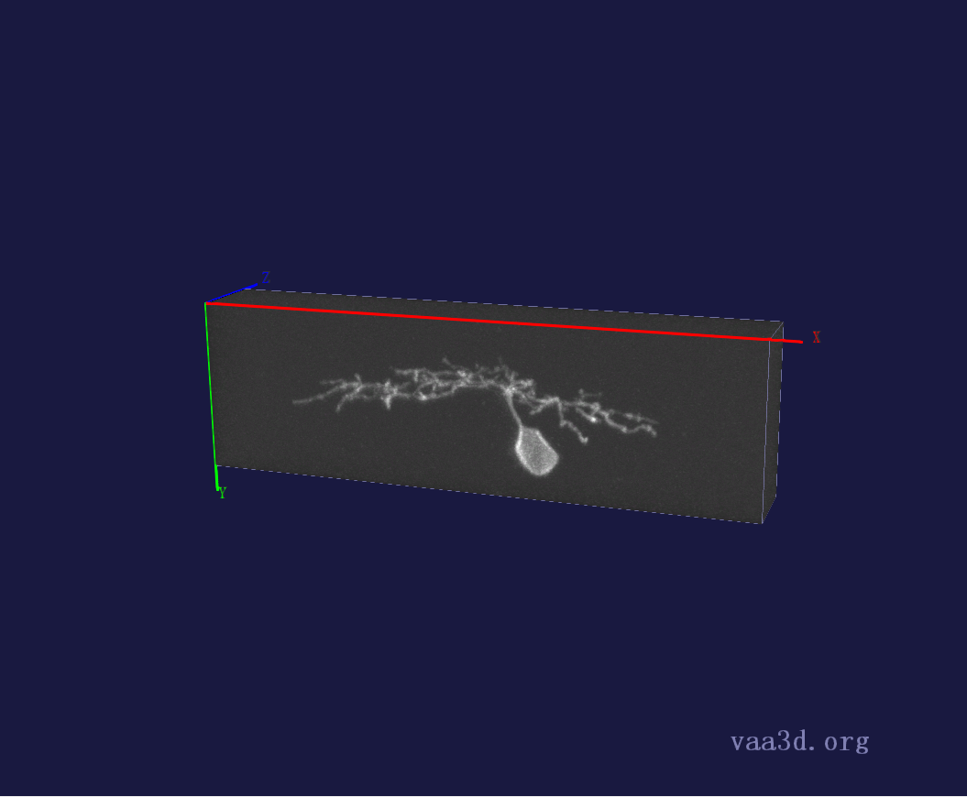
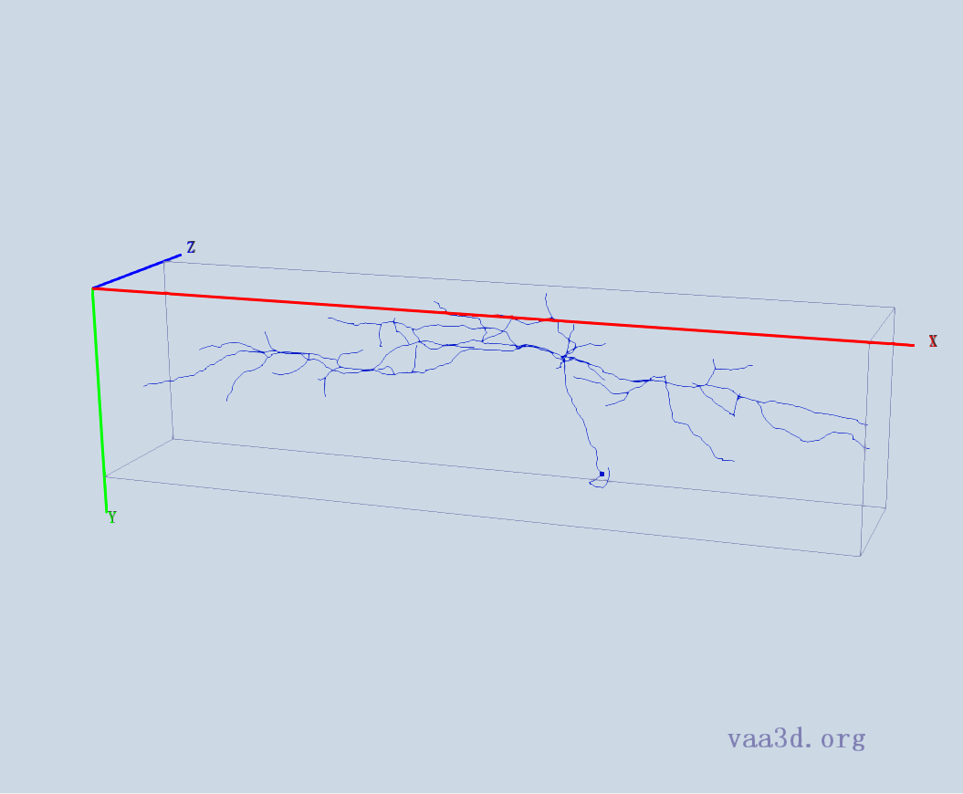
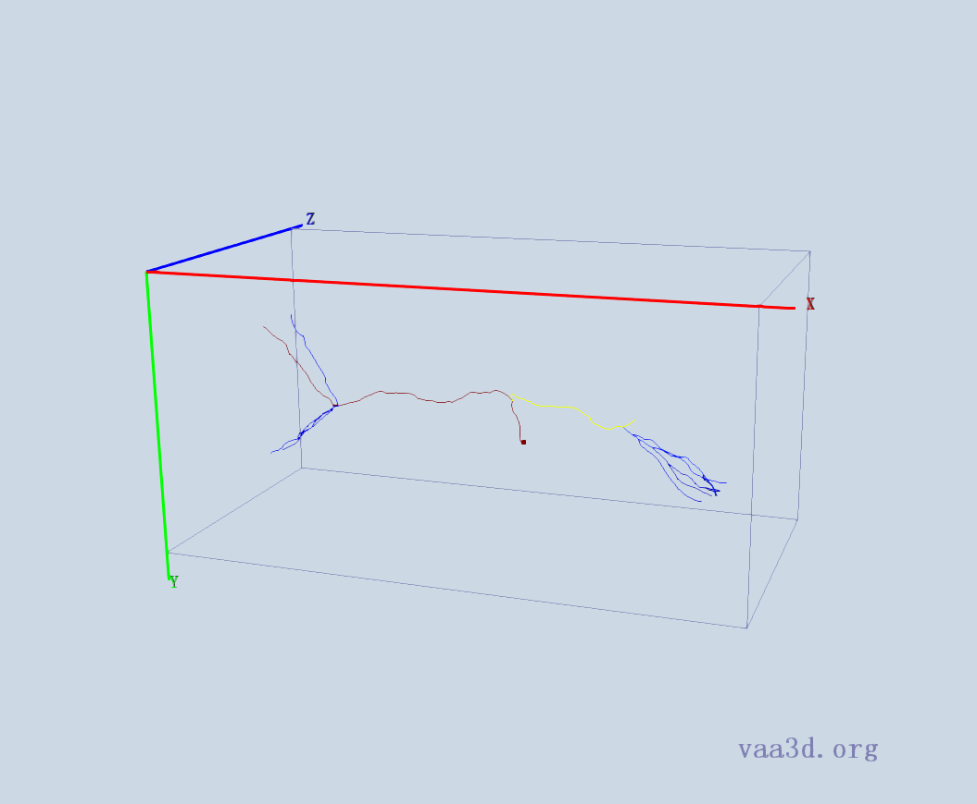
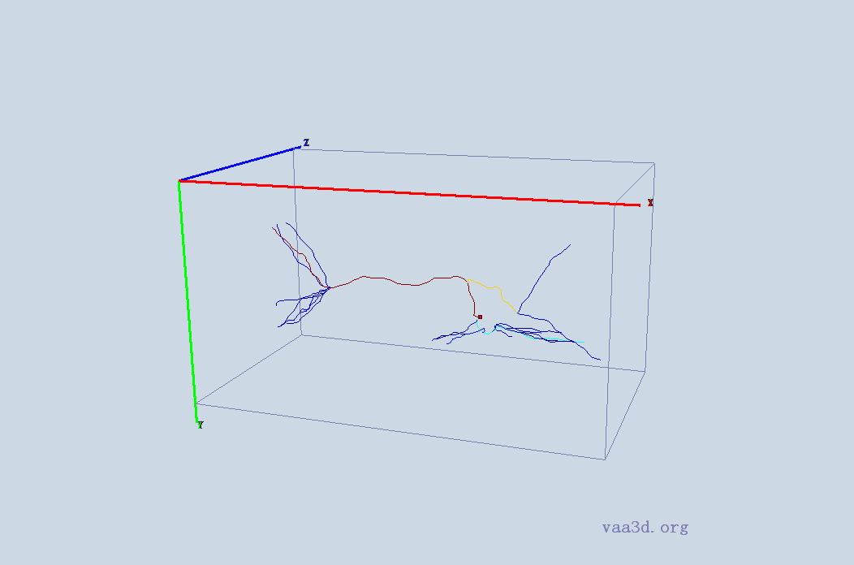
1_5dpf_Live_1-30-2010_12-39-26_PM_med_Red
GT
Thre=AUTO
Thre=15
Thre=30
Thre=20
Thre=25

Slide 2
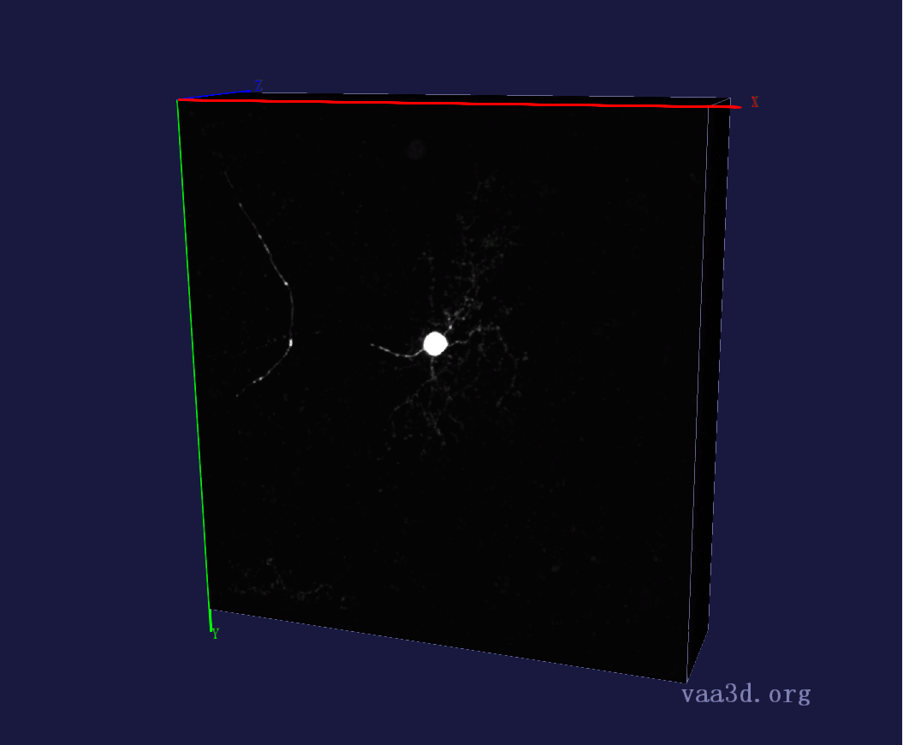
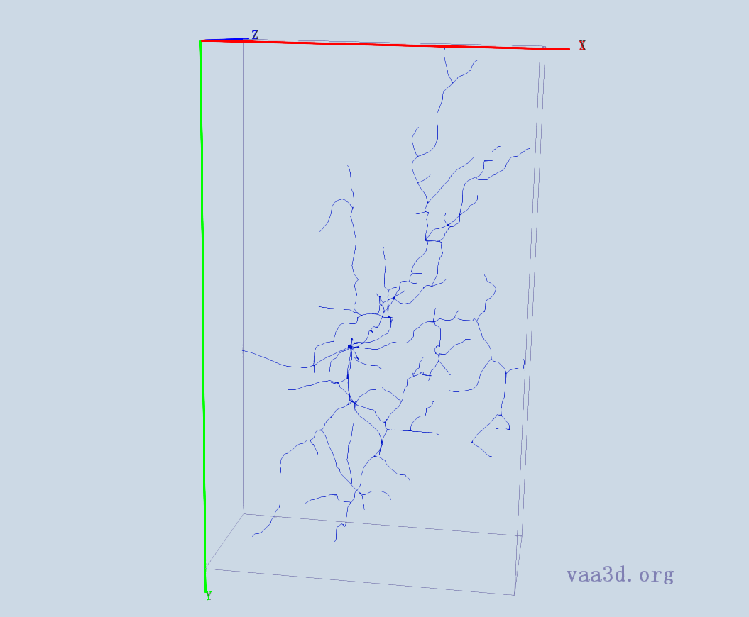
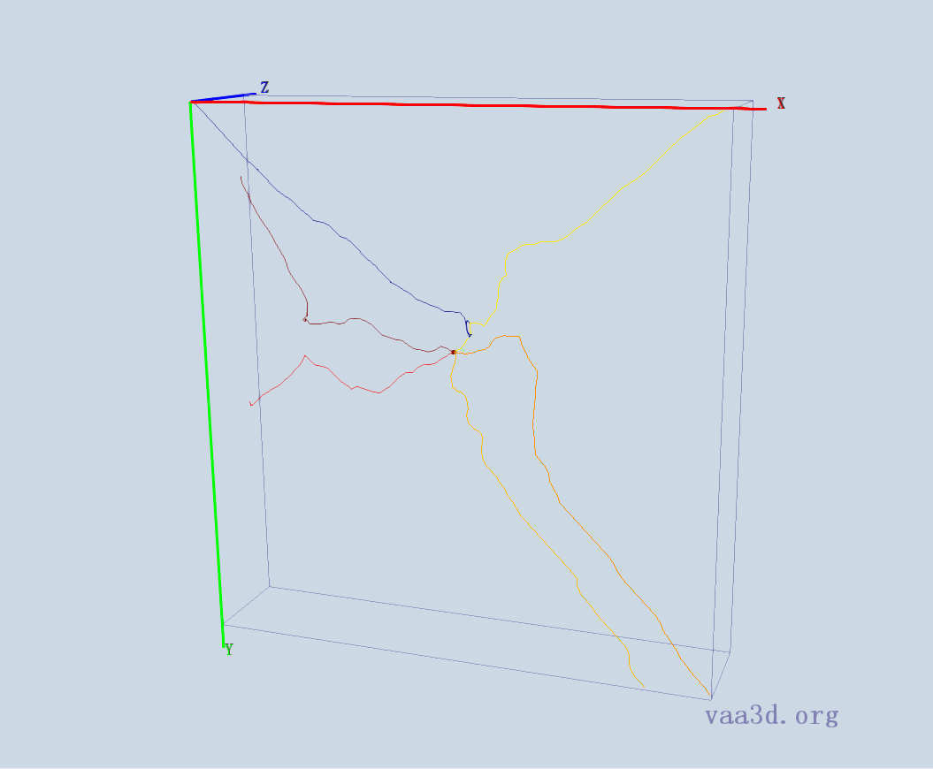
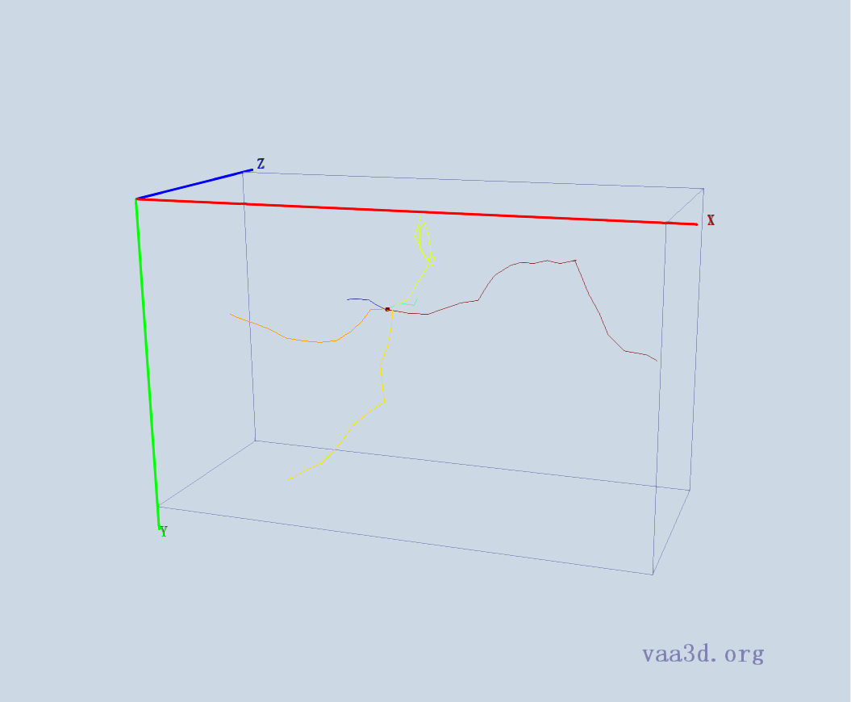
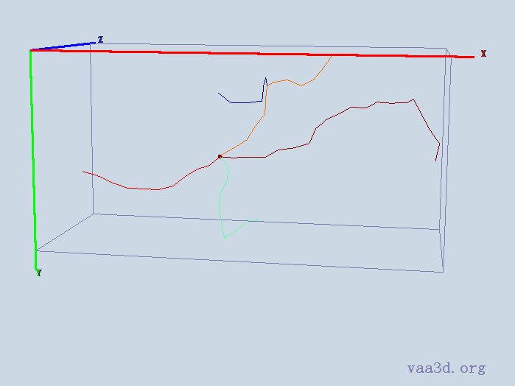
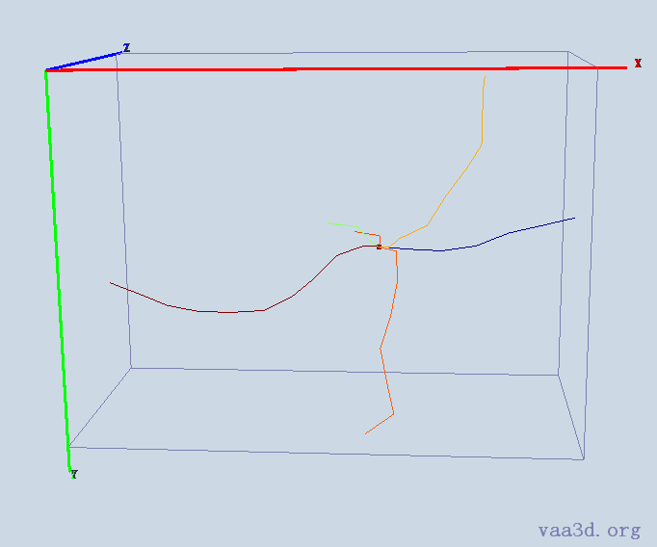
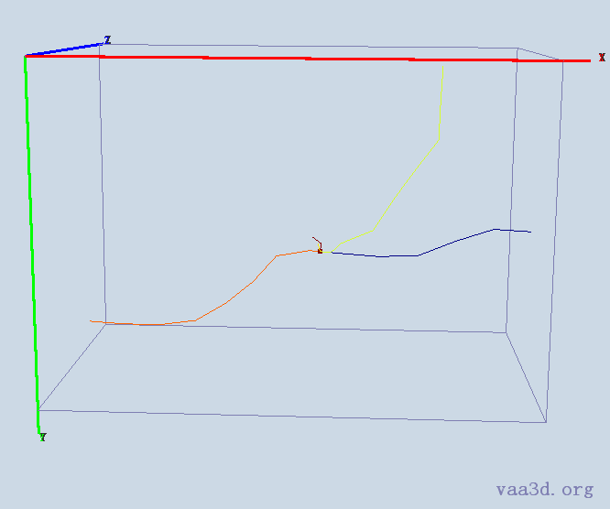
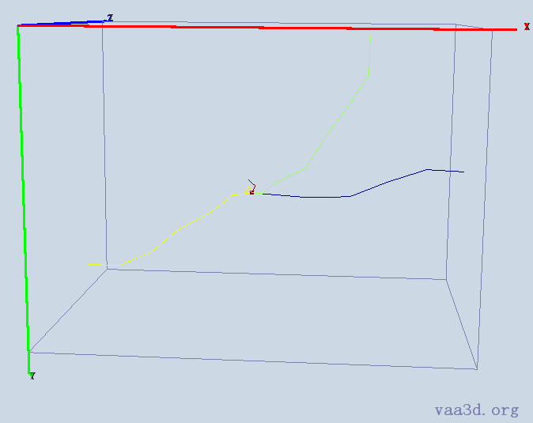
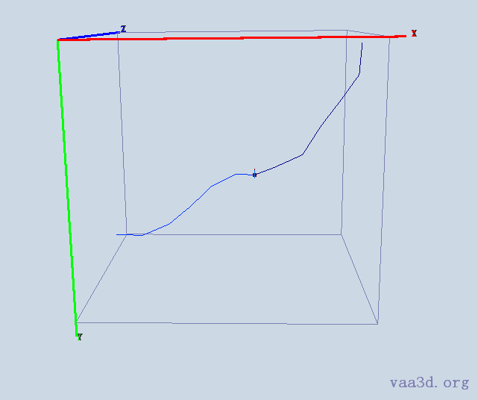
1_8_Ch2
GT
Thre=1
Thre=5
Thre=AUTO
Thre=30
Thre=15
Thre=20
Thre=25

Slide 3
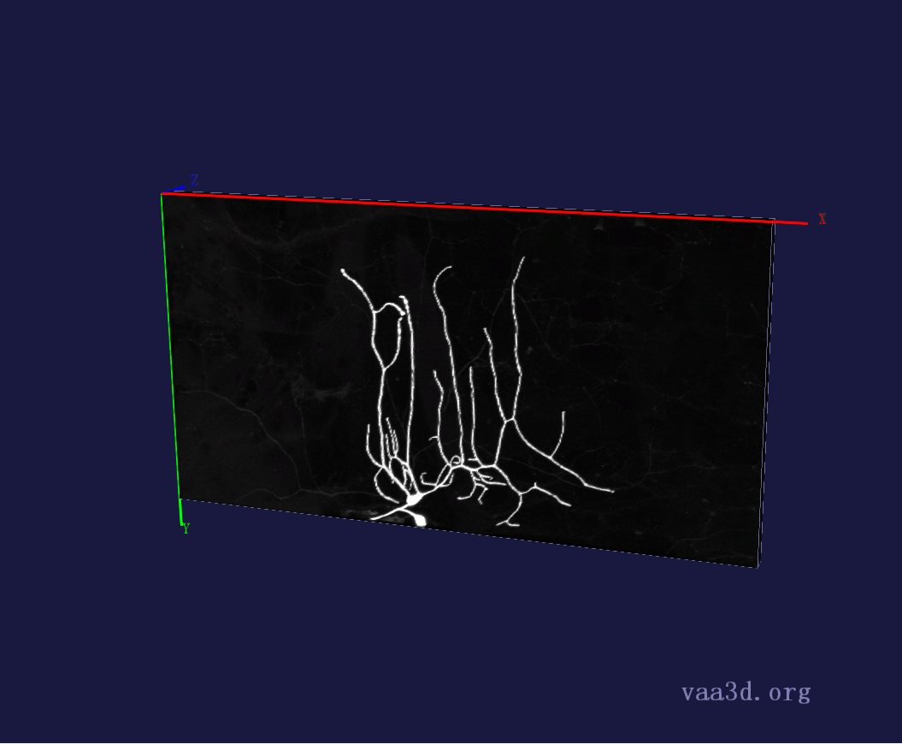
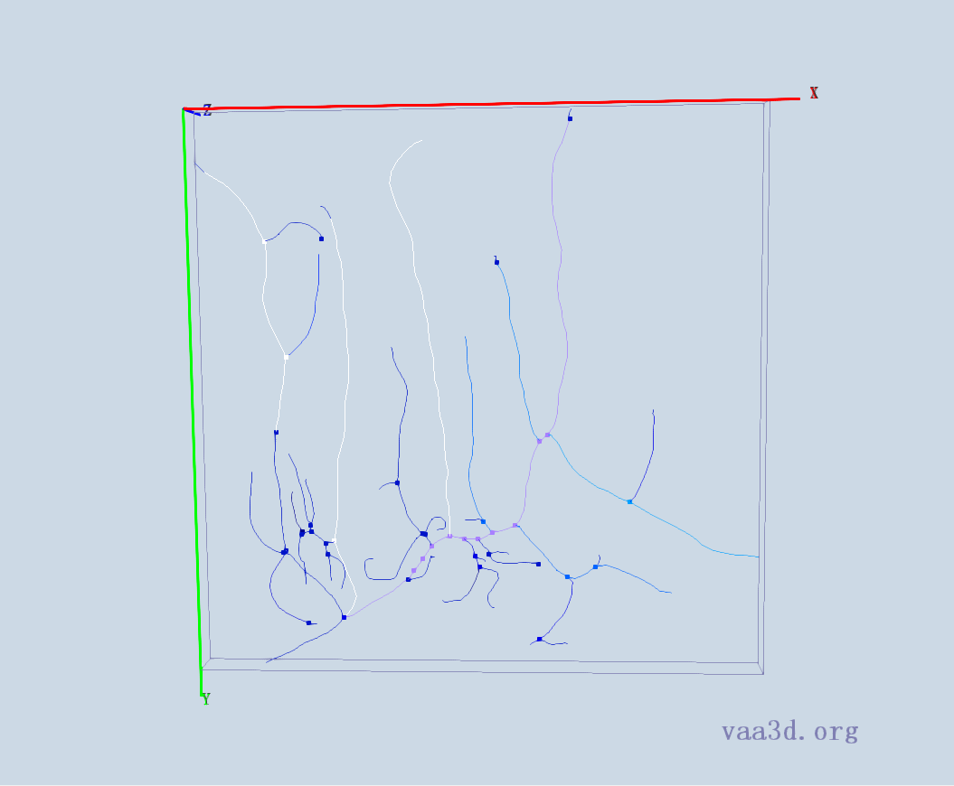
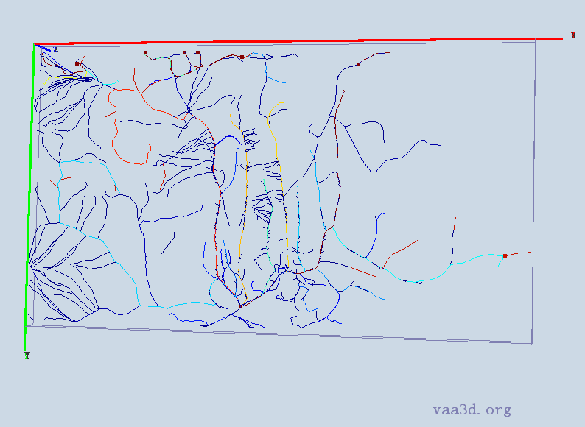
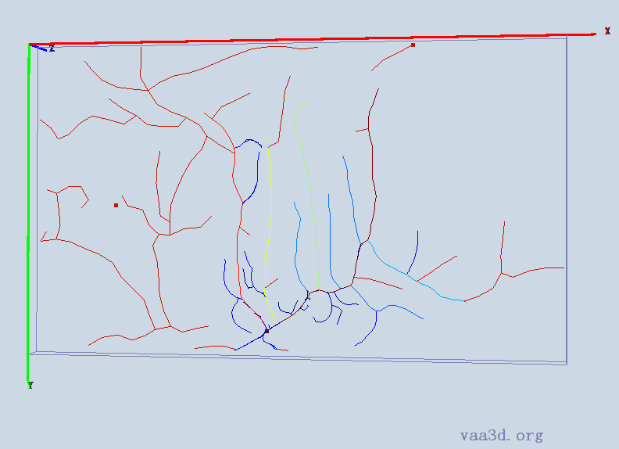
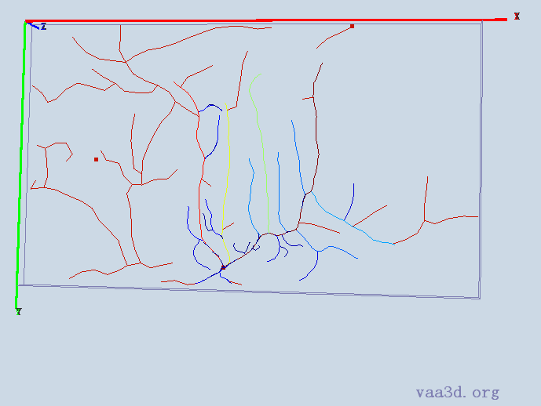
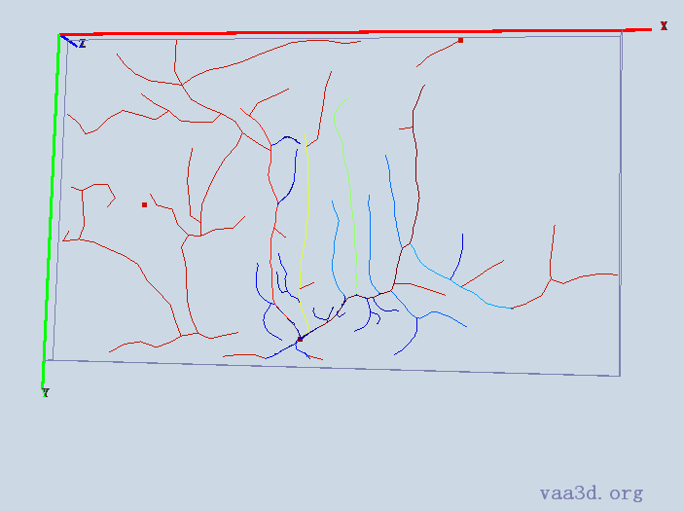
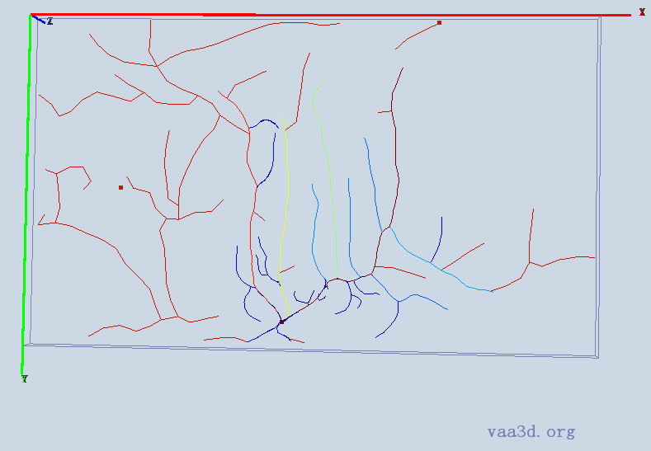
2_CL-I_Membrane-GFP_X_F-Actin-Red_ddaE
GT
Thre=AUTO
Thre=15
Thre=30
Thre=20
Thre=25

Slide 4
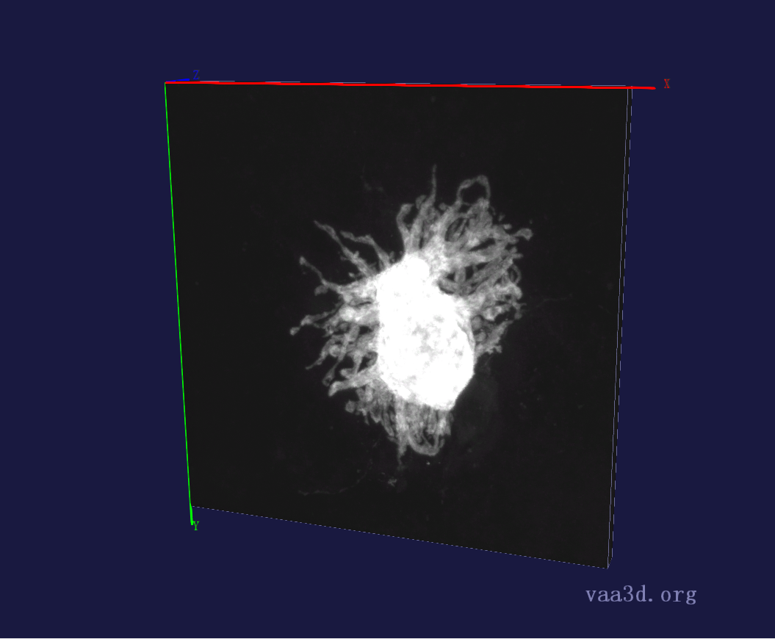
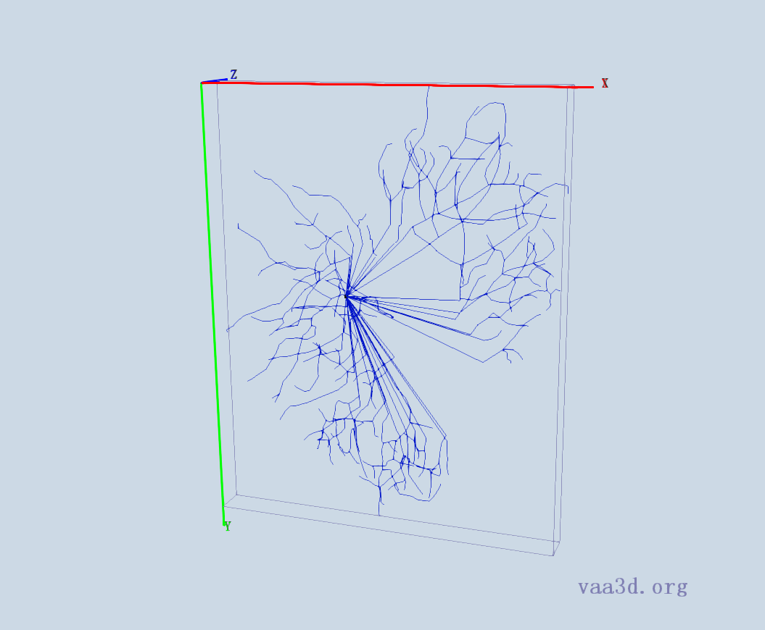
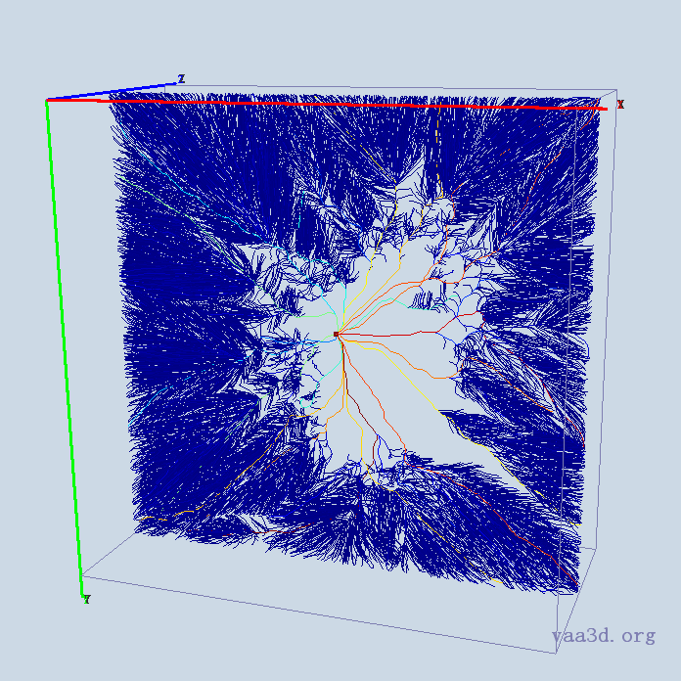
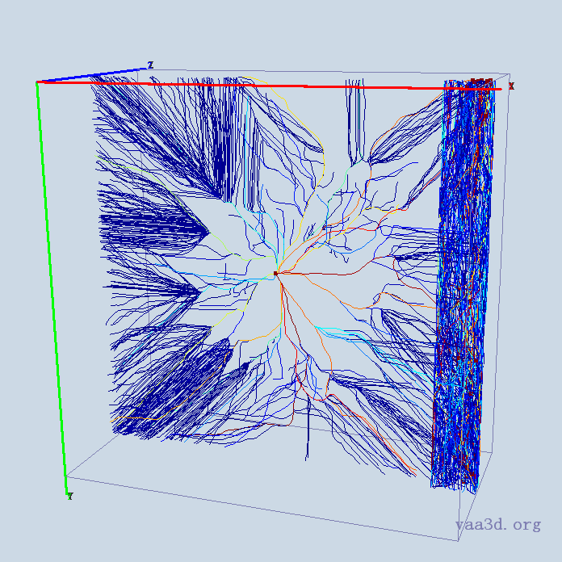
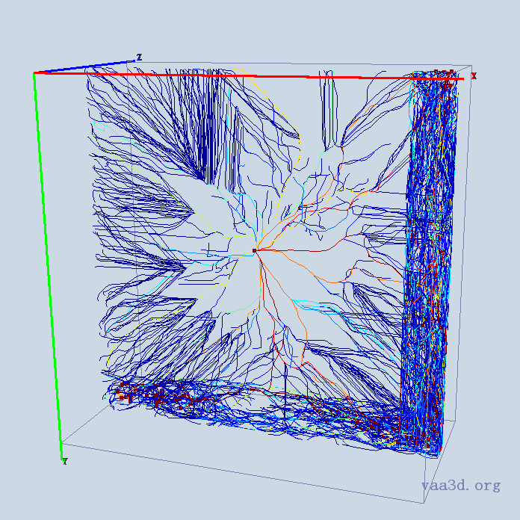
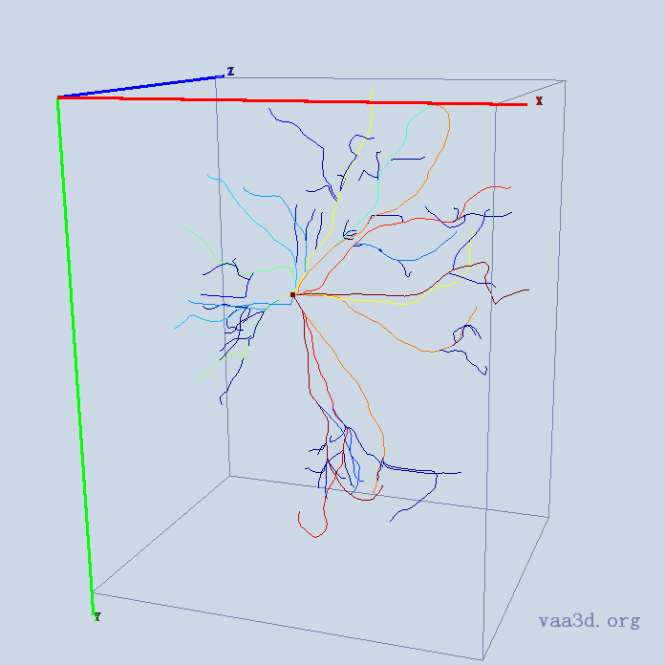
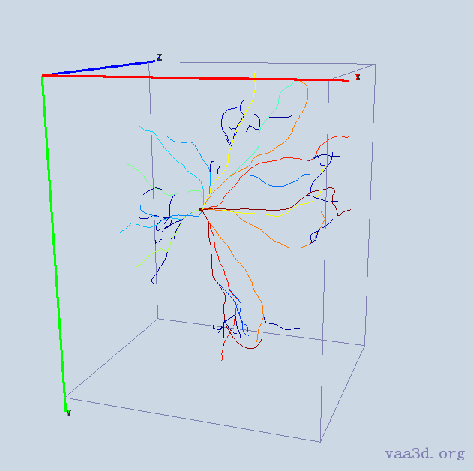
10-2909-s5-left-cell3_merge_c2
10-2909-s5-left-cell3_merge_c2
GT
Thre=AUTO
Thre=15
Thre=20
Thre=25
Thre=30

Slide 5
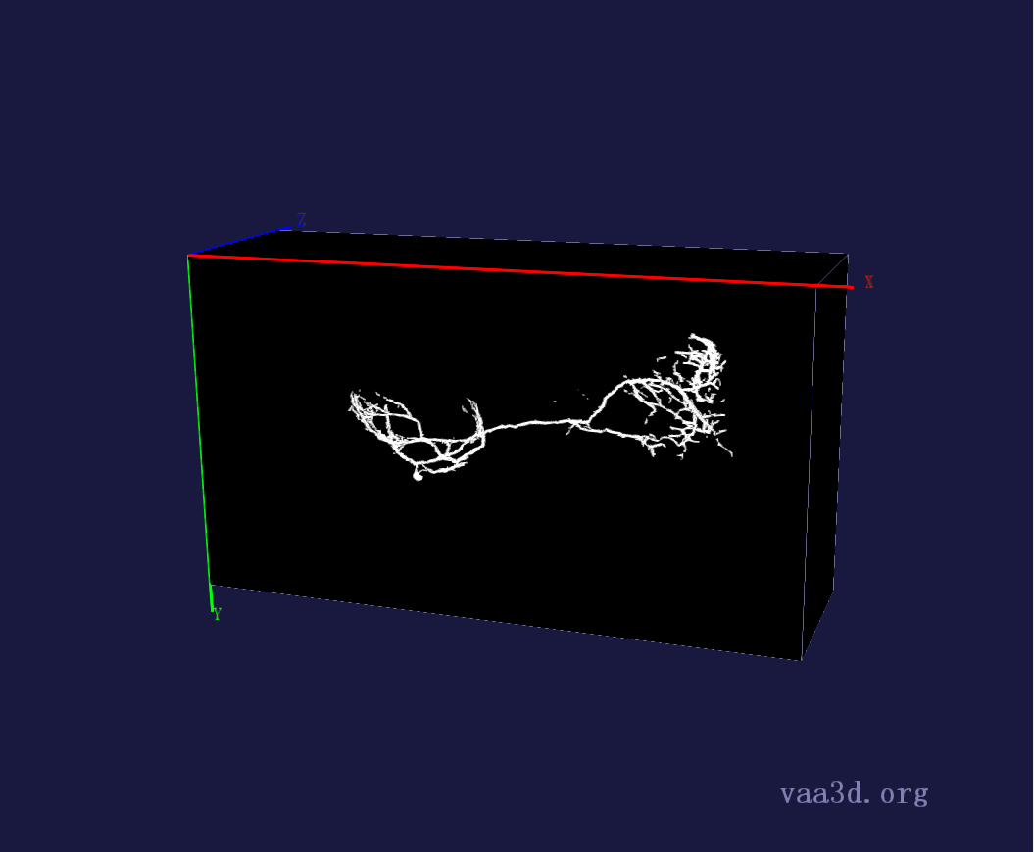
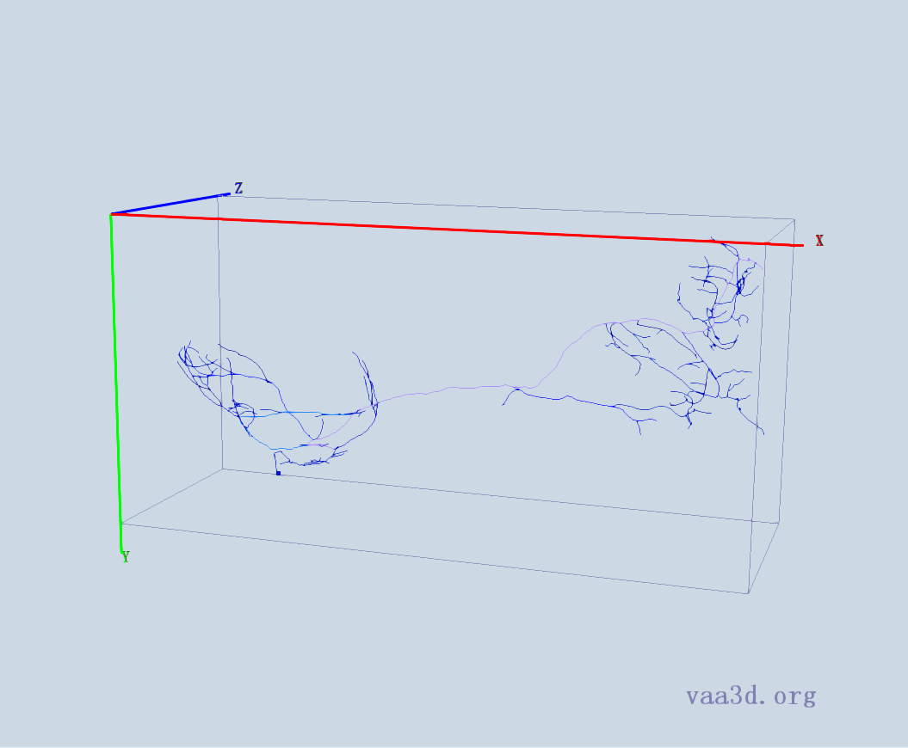
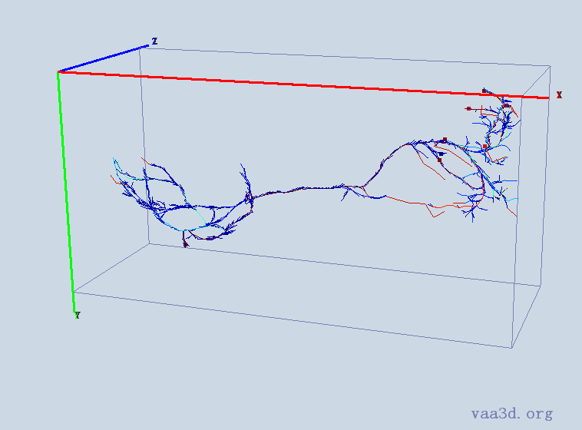
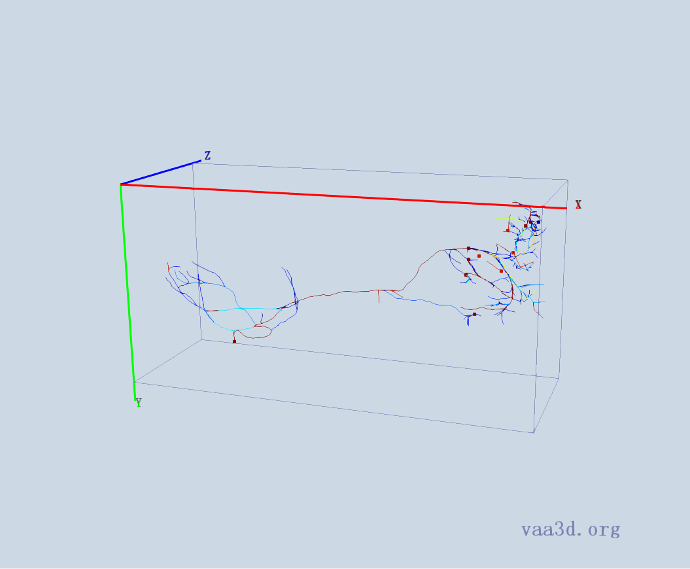
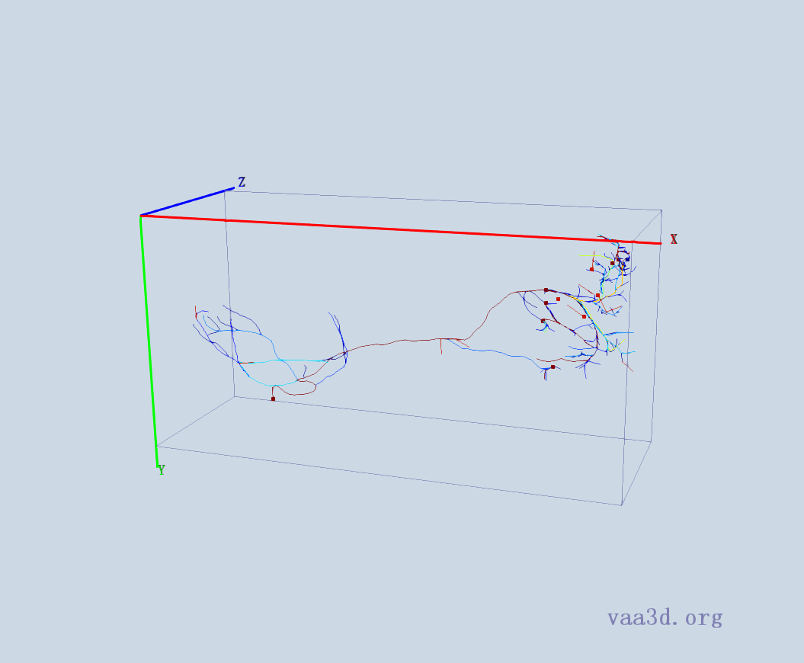
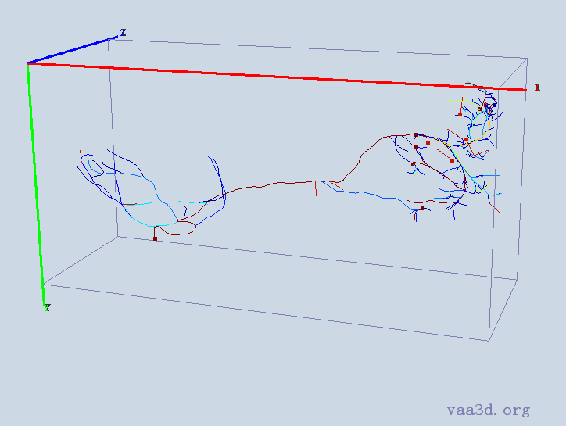
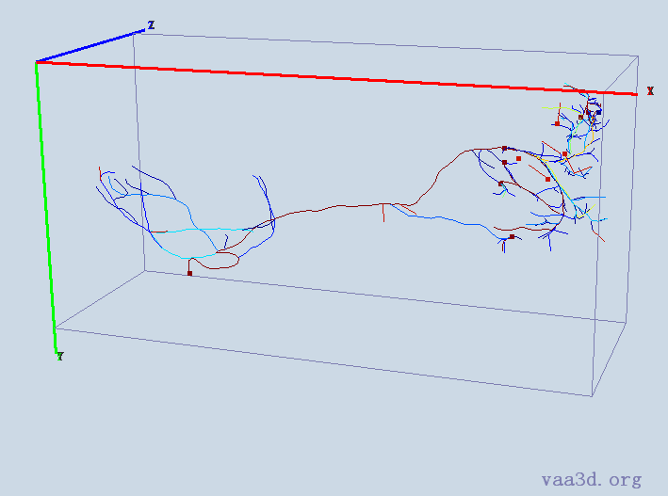
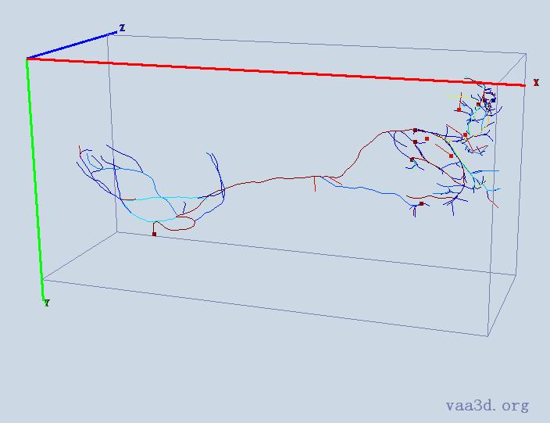
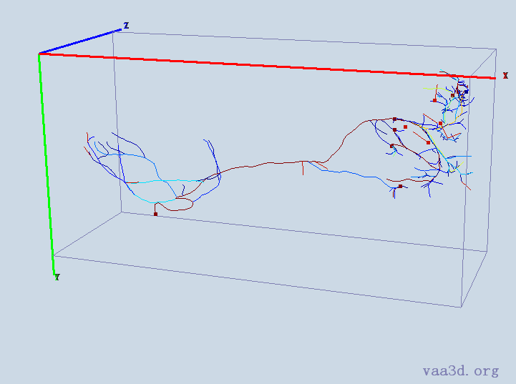
0664_seg
GT
Thre=AUTO
Thre=5
Thre=10
Thre=15
Thre=20
Thre=25
Thre=30

Slide 6
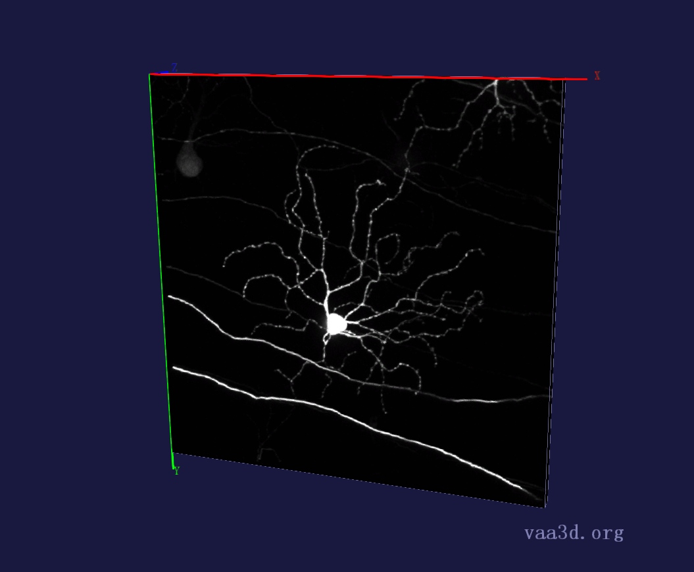
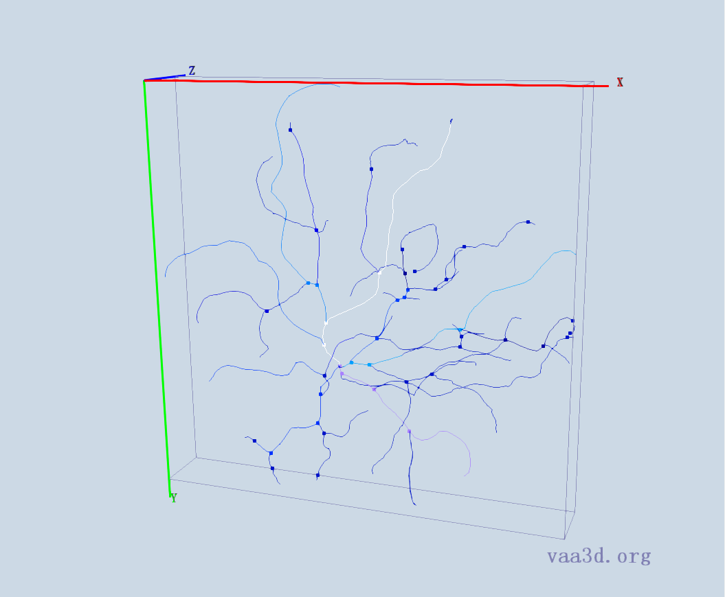
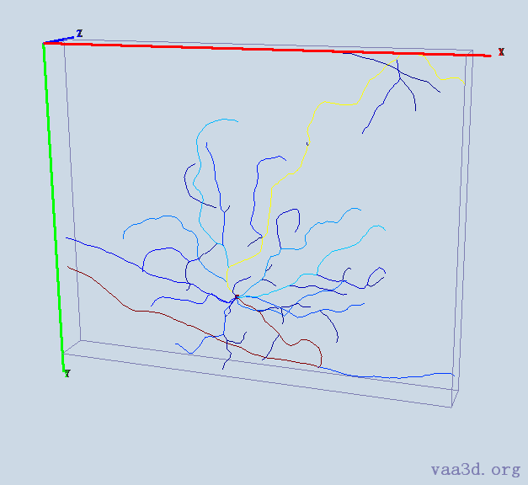
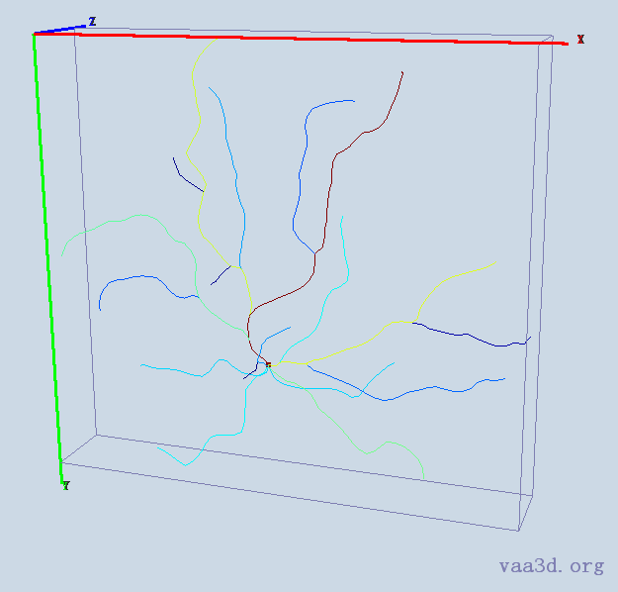
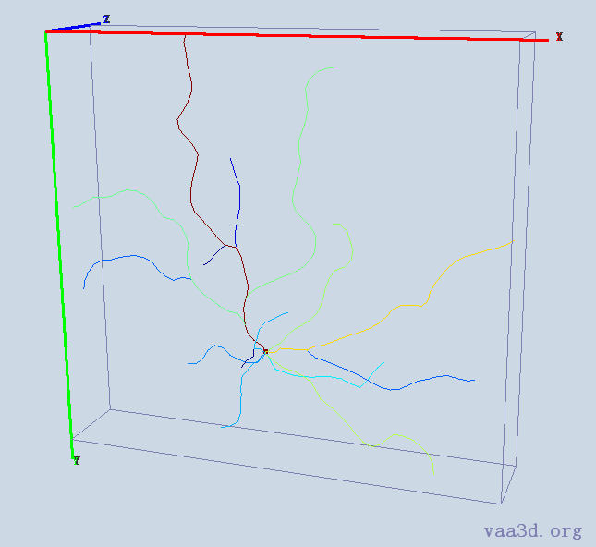
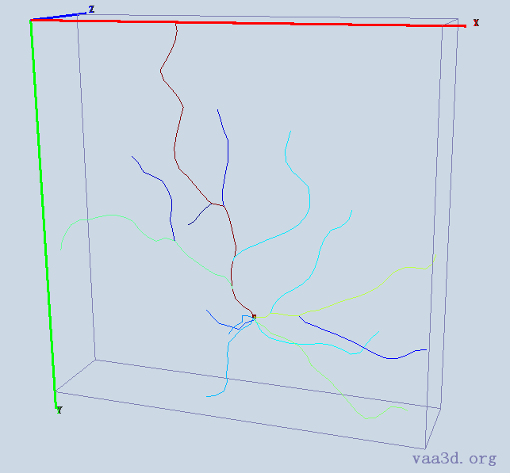
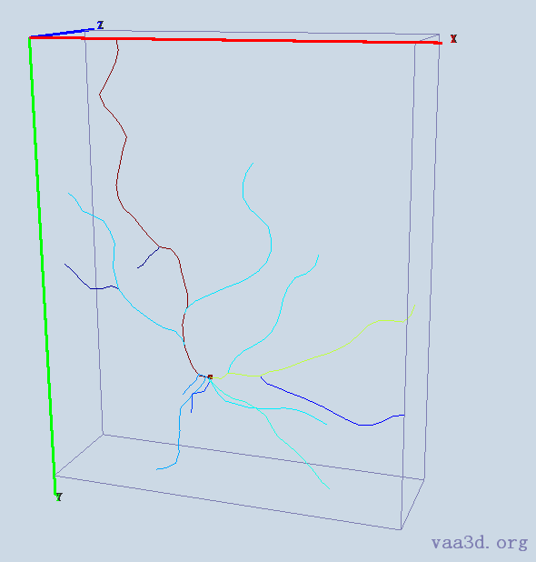
140918c8
GT
Thre=AUTO
Thre=15
Thre=20
Thre=25
Thre=30

Slide 7
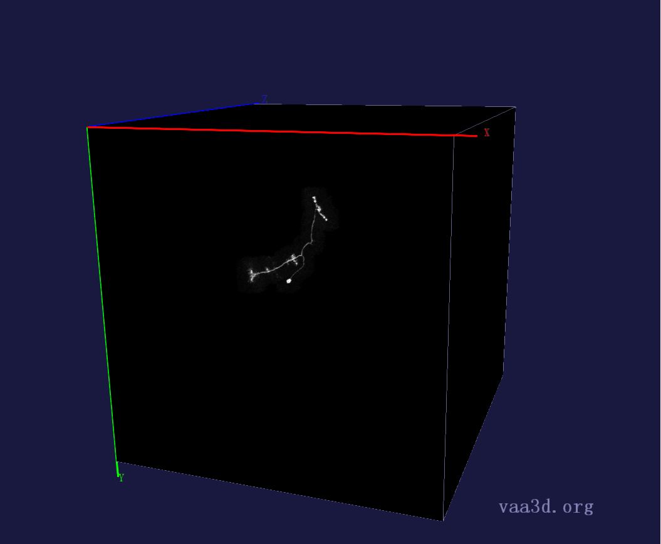
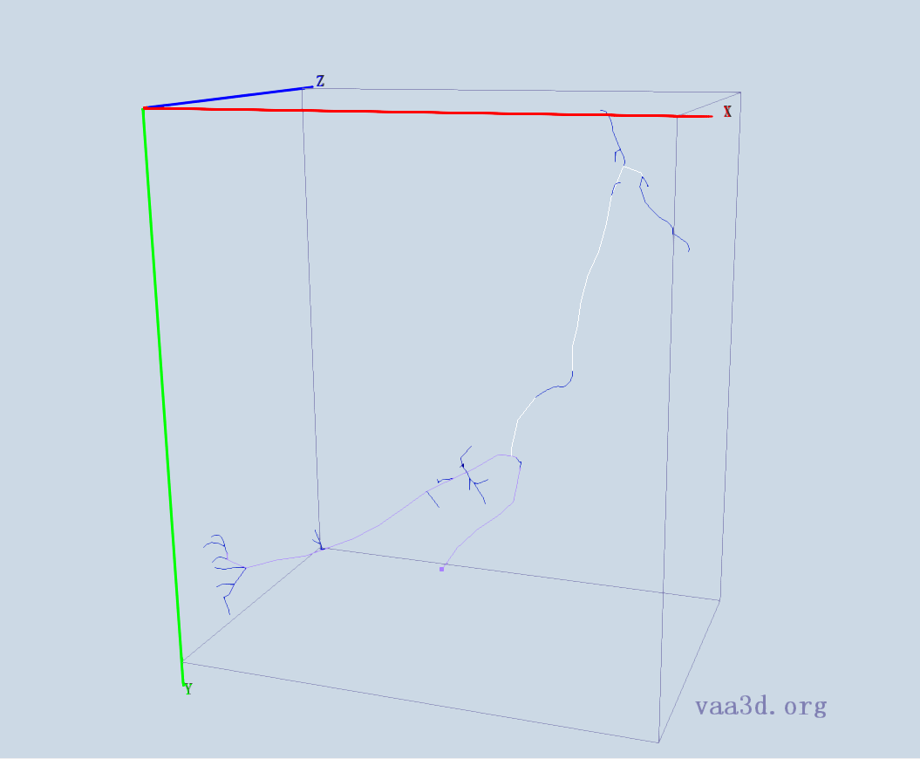
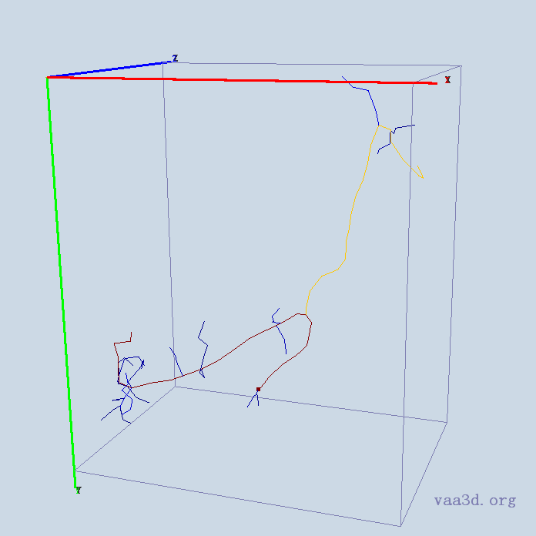
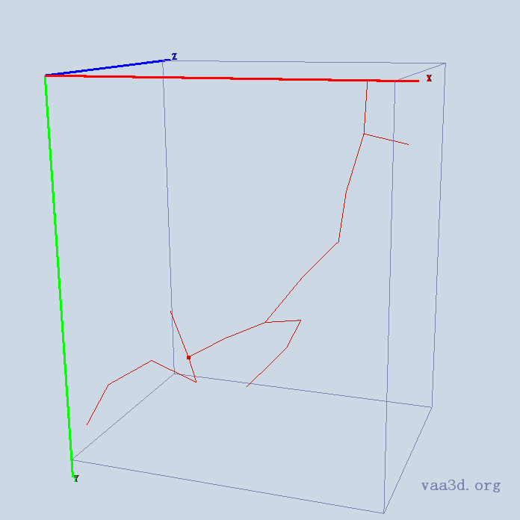
GMR_A3-
GT
Thre=AUTO
Thre=15
Thre=30
Thre=20
Thre=25

Slide 8
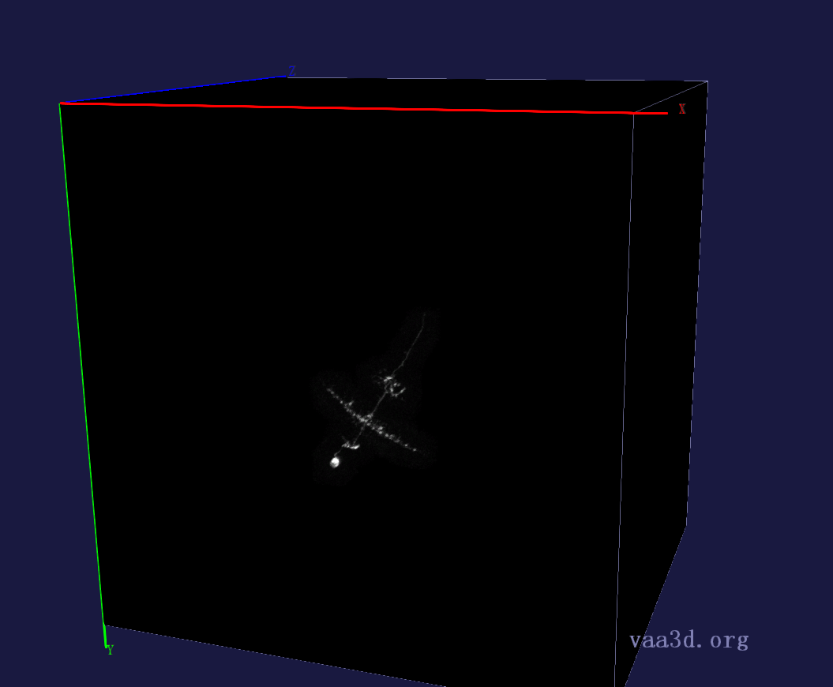
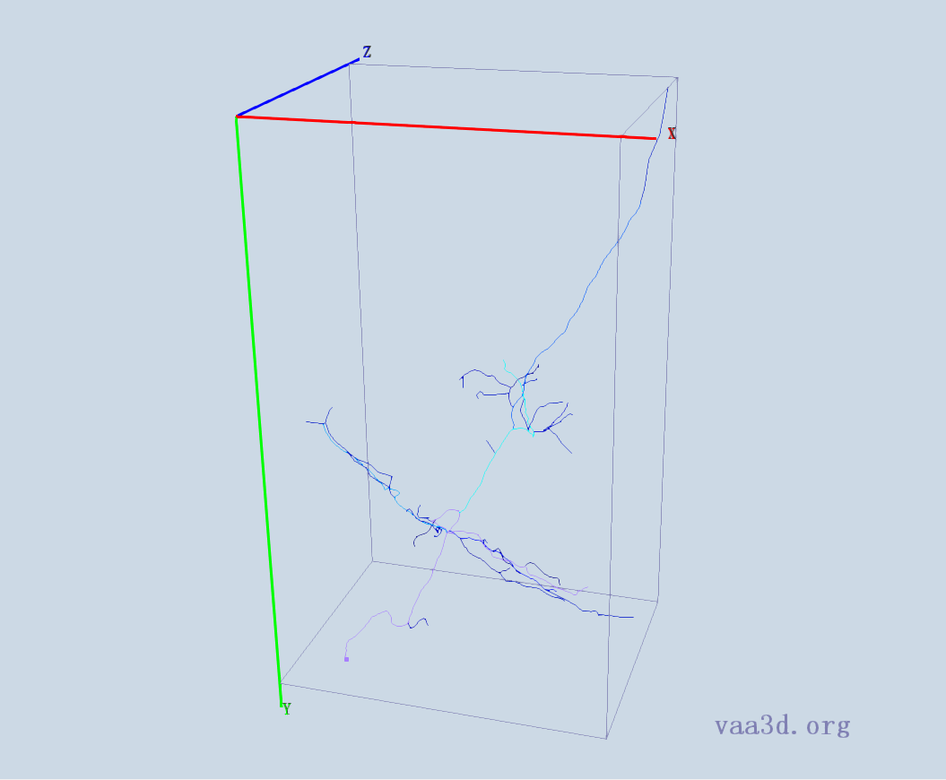
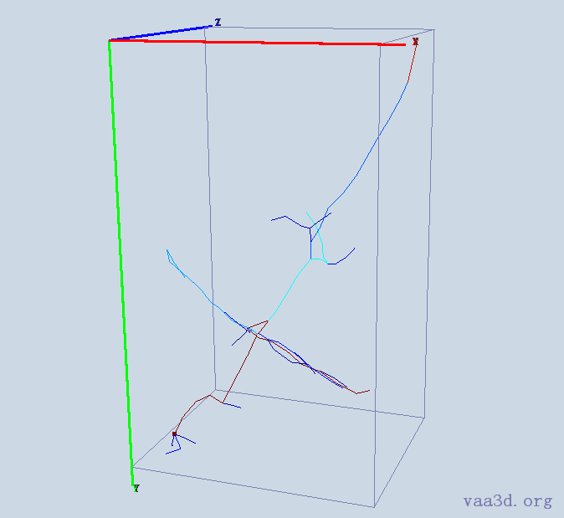




GMR_B2
GT
Thre=AUTO
Thre=15
Thre=20
Thre=25
Thre=30

Slide 9










GMR_D3
GT
Thre=1
Thre=5
Thre=10
Thre=AUTO
Thre=15
Thre=20
Thre=25
Thre=30

Slide 10







GMR_C1
GT
Thre=AUTO
Thre=15
Thre=30
Thre=20
Thre=25

Slide 11





GMR_D2
GT
Thre=AUTO
Thre=15
Thre=20
Thre=25
Thre=30

Slide 12







GMR_E1
GT
Thre=AUTO
Thre=15
Thre=20
Thre=25
Thre=30

Slide 13







GMR_E2
GT
Thre=AUTO
Thre=15
Thre=20
Thre=25
Thre=30

Slide 14







GMR_E4
GT
Thre=AUTO
Thre=15
Thre=20
Thre=25
Thre=30

Slide 15







GMR_F3
GT
Thre=AUTO
Thre=15
Thre=20
Thre=25
Thre=30

Slide 16







Image-7
GT
Thre=AUTO
Thre=15
Thre=20
Thre=25
Thre=30

Slide 17







Image-10
GT
Thre=AUTO
Thre=15
Thre=20
Thre=25
Thre=30

